Slide 1
Virtual machine scale sets
Vaishnav Nandikanti – 21891A0563
Kuncham Sai Suvarna – 21891A0527
Telugu Archana – 21891A0556
Boda Chandana – 21891A05D7

Slide 2
AIM:
Aim:
To deploy a highly available and scalable website using Azure Virtual Machine Scale Sets (VMSS) and ensures automatic scaling based on demand, high availability through load balancing, and efficient resource management by leveraging Azure services like custom scripts, VM images, autoscaling, and monitoring.

Slide 3
AIM:
Virtual Machine
A virtual machine(VM) is similar to any other physical computer like a laptop, smart phone, or server. It has a CPU, memory, disks to store your files, and can connect to the internet if needed. While the parts that make up your computer (called hardware) are physical and tangible, VMs are often thought of as virtual computers or software-defined computers within physical servers, existing only as code.
Virtual Machine Scale Sets
Azure Virtual Machine Scale Sets allows to create and manage a group of load balanced VMs. The number of VM instances can automatically increase or decrease in response to demand or a defined schedule.

Slide 4
AIM:
Load Balancer
Load balancing is a process in which distribute incoming traffic equitably across multiple computers. Load balancing is a process in which you distribute incoming traffic equitably across multiple computers.
Image Gallery
An image is a copy of either a full VM (including any attached data disks) or just the OS disk, depending on how it's created. When you create a VM from the image, a copy of the VHDs in the image are used to create the disks for the new VM. The image remains in storage and can be used over and over again to create new VMs.

Slide 5
services used:
Azure Virtual Machine Scale Sets (VMSS) – For automatic scaling and high availability.
Azure Virtual Machines (VMs) – To host the website and create an image for VMSS.
Azure Load Balancer – For distributing traffic across multiple VM instances.
Azure Custom Script Extension – To automate VM configuration and website deployment.
Azure Image Gallery – To store and manage reusable VM images.
Azure Autoscale – To automatically adjust the number of VM instances based on CPU usage.
Azure Monitor & Metrics – For tracking performance and monitoring autoscaling behavior.

Slide 6
Steps
Create website
Upload website in github
Create VM with custom script
Verify website deployment
Capture the image
Create VMSS using Captured Image
Verify the image in VMSS
Configure autoscaling and Load balancer
Create VMSS
Verify website availability
Configure Inbound Rule and Stress Test
Monitor Metrics and Autoscaling
Verify High Availability

Slide 7
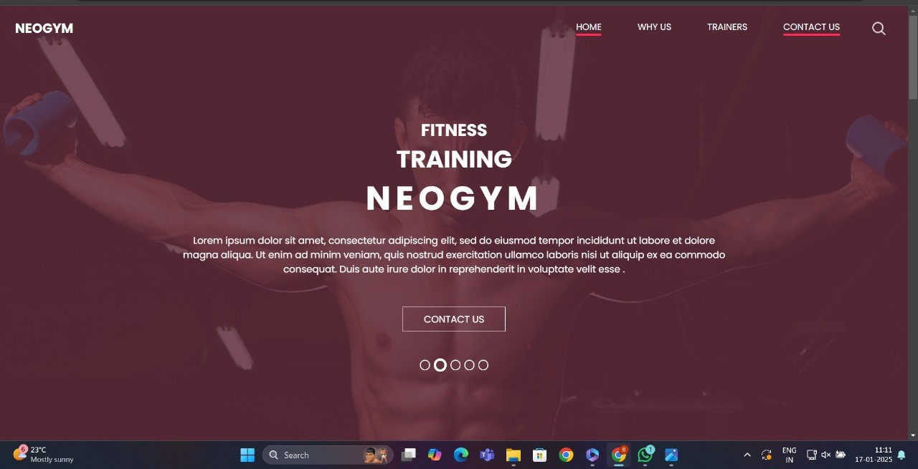
Website Deployment

Slide 8
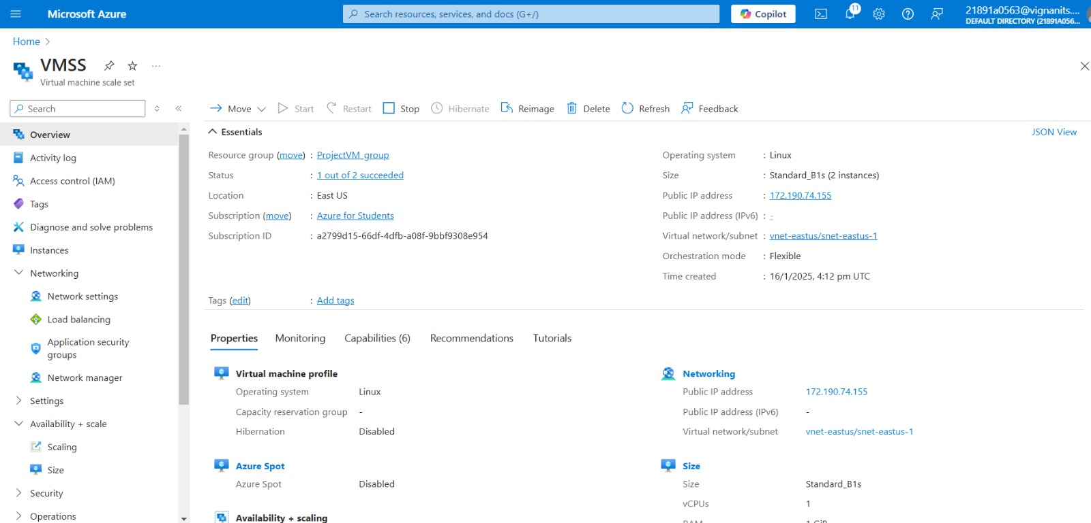
Virtual Machine Scale Sets Deployment

Slide 9
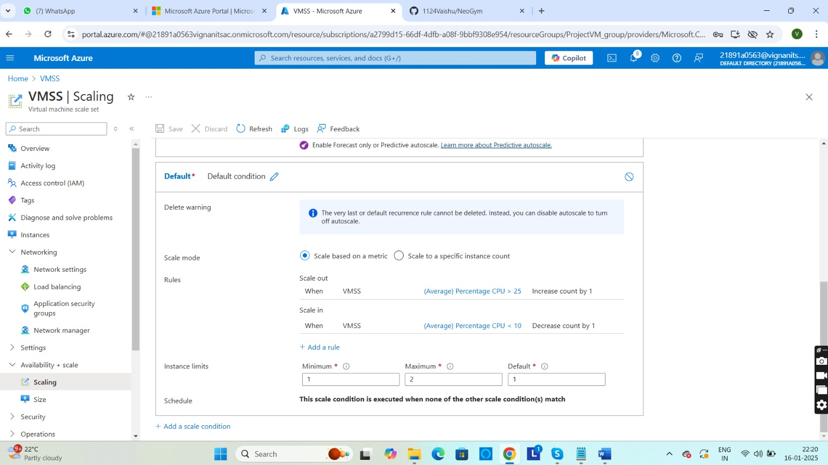
VMSS - Scaling

Slide 10
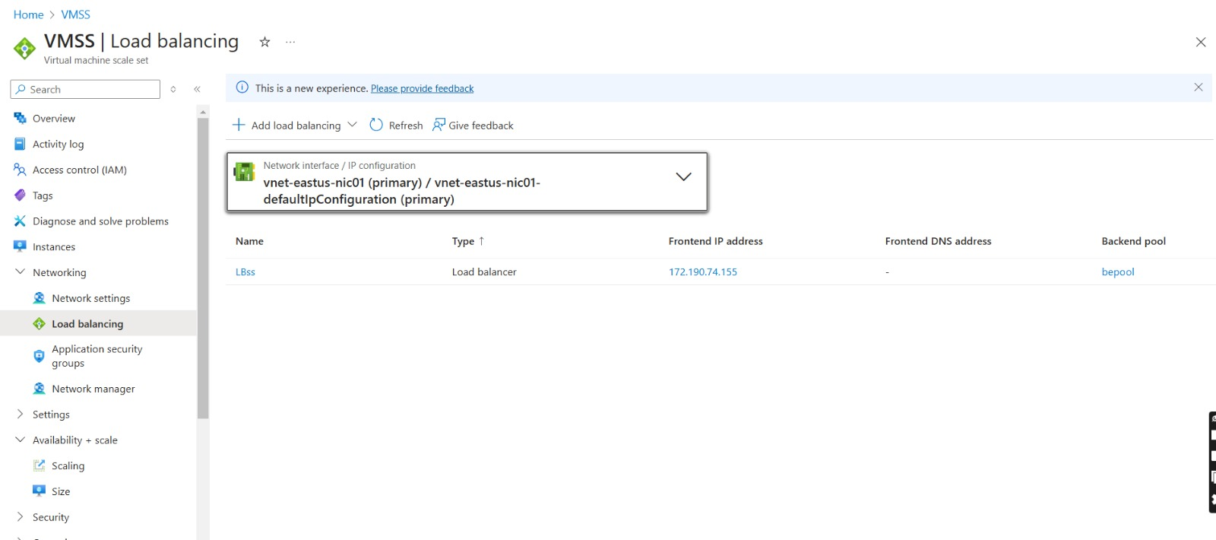
VMSS – Load Balancing

Slide 11
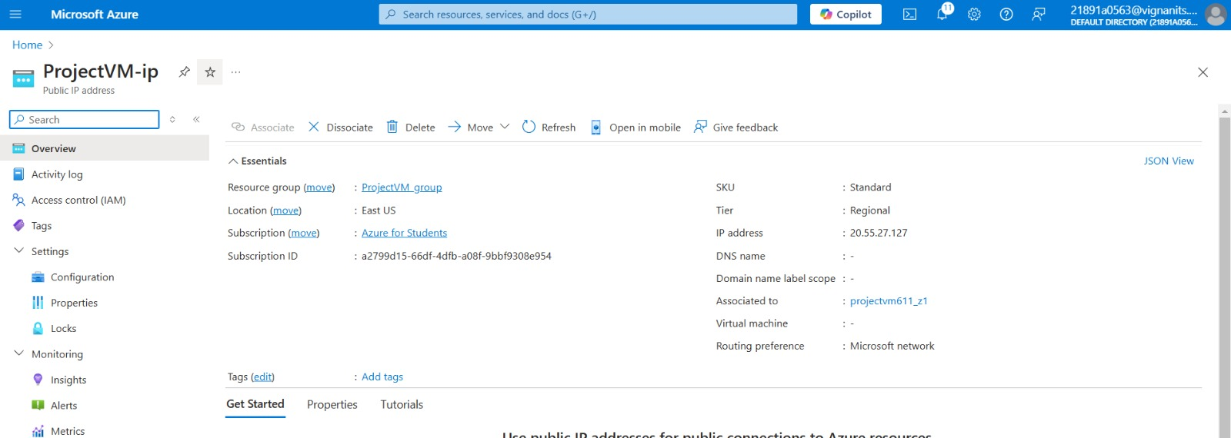
ProjectVM - IP

Slide 12
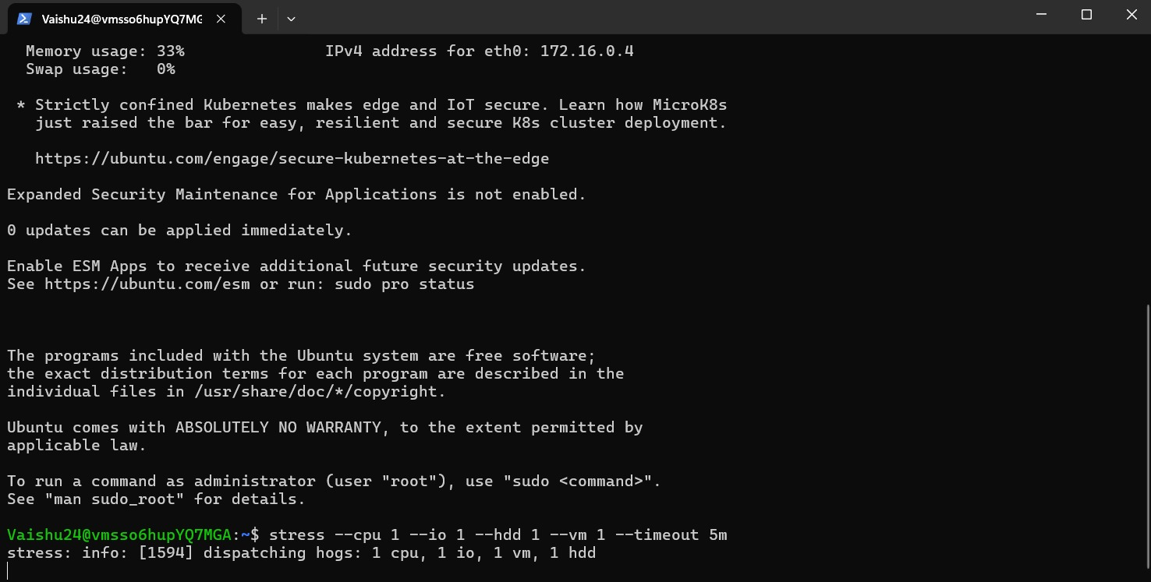
Terminal Window to get System Information

Slide 13
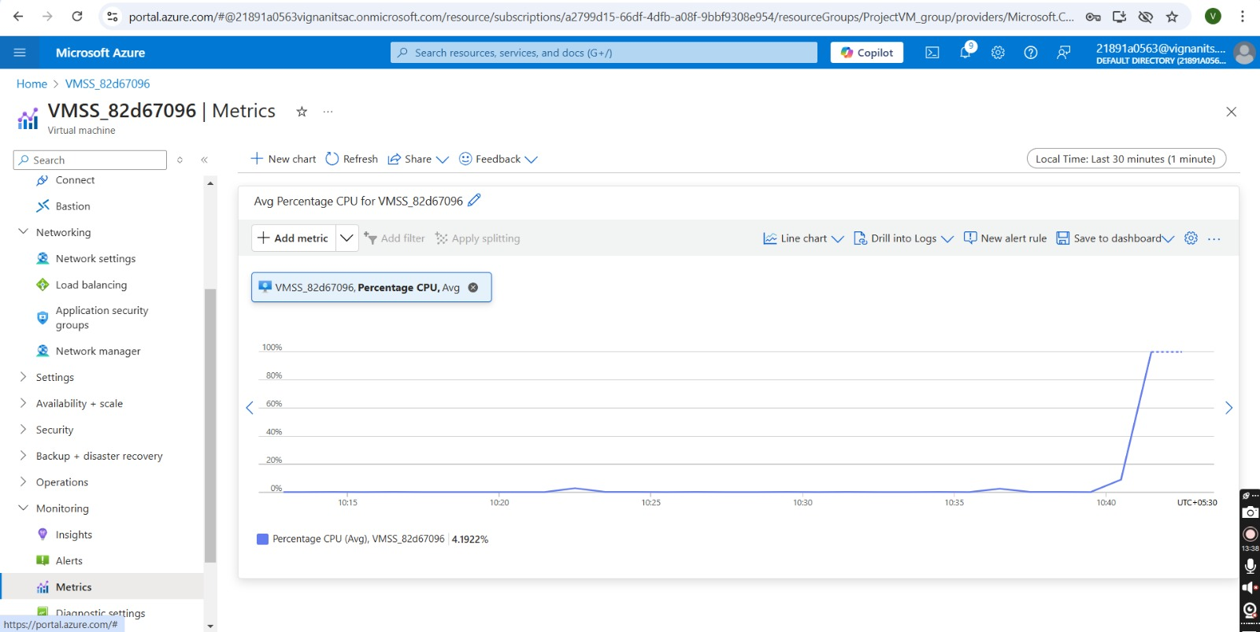
VMSS – Metrics(Graph of Average CPU Percentage)

Slide 14
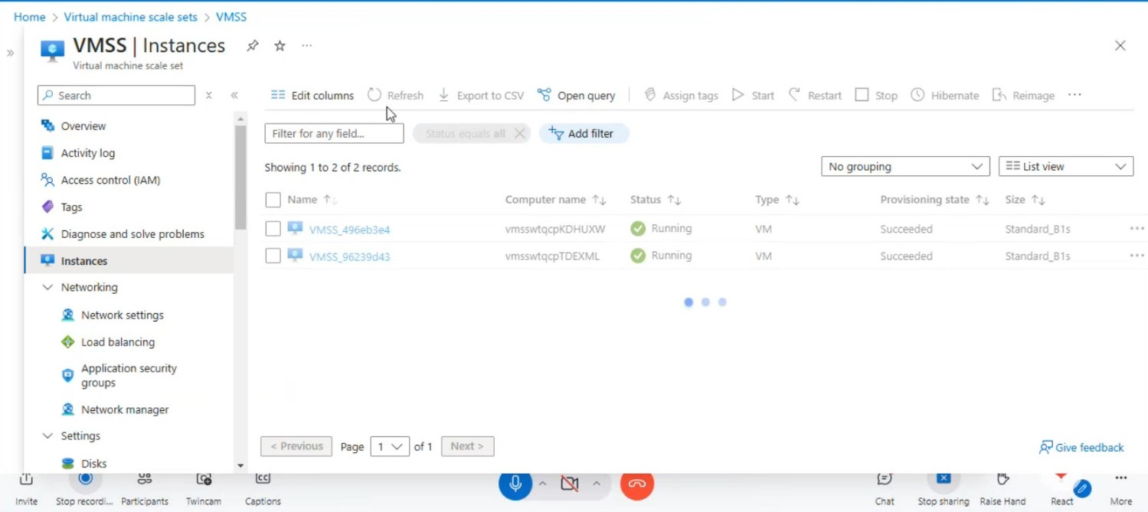
Virtual Machine Scale Set Instances

Slide 15
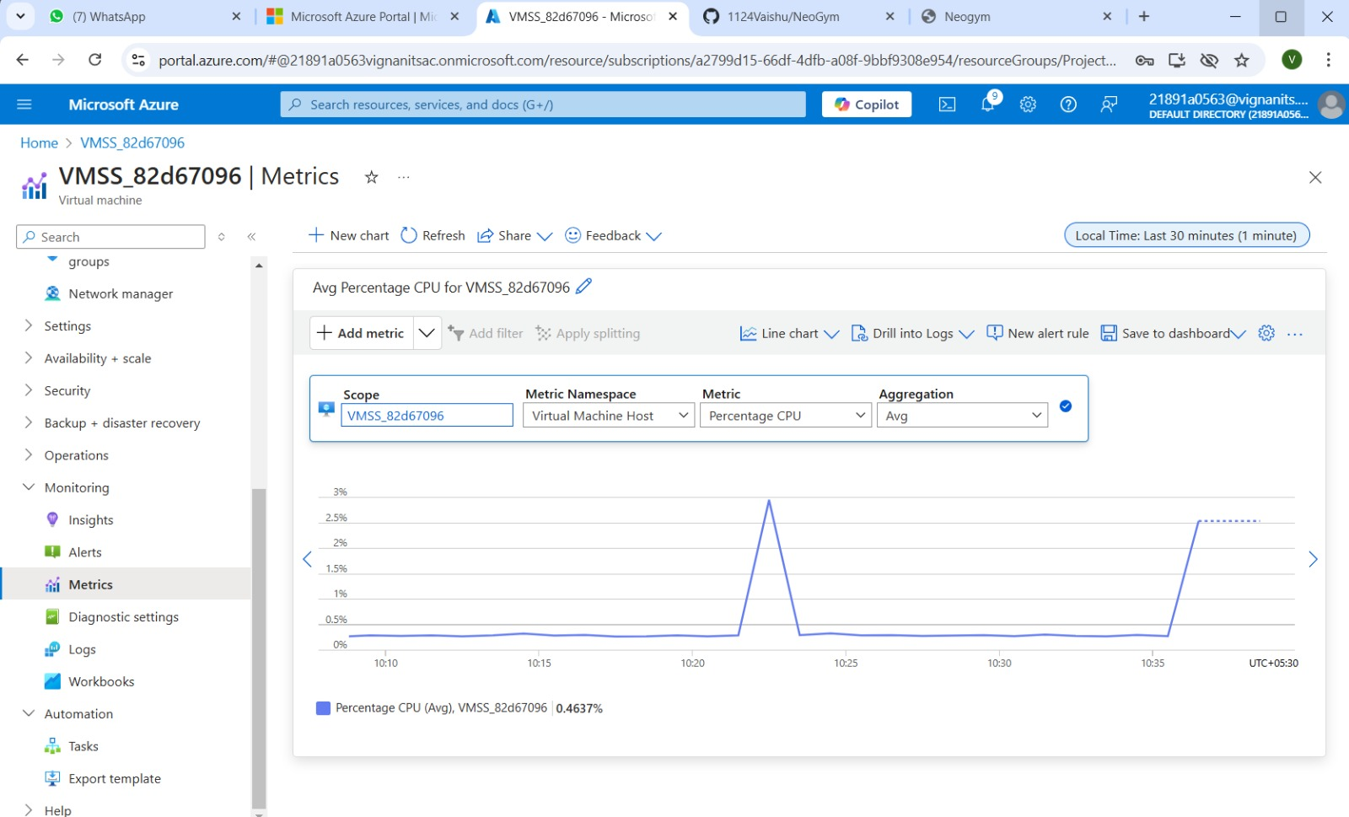
VMSS Metrics(Graph of Average CPU Percentage Over Time)

Slide 16
Thank You
Conclusion:
By leveraging Azure services such as Load Balancer, Autoscale, and Custom Script Extension, the system ensures efficient resource management and automatic scaling based on demand. The implementation guarantees high availability by distributing traffic across multiple instances and monitoring performance metrics. It demonstrates the deployment of a highly available and scalable website using Azure Virtual Machine Scale Sets (VMSS).

Slide 17


